Slide 1

Final Review
Major Project Winter Semester-2024-25
Department of Electronics and Communication Engineering
Data Logger For Industry 4.0
Domain: VLSI
Date: 06/05/2025
Project Team Members
VTU 21016 (R. Sai Gowtham)
VTU 20086 (M. Bhanu Vasanth)
VTU 21150 (T. Pavan kishore)
Supervisor:
Dr. Arun C A
Associate Professor

Slide 2
Agenda:-
Abstract
Introduction
Literature Survey
Objective
Block Diagram & Flow chart
Design & Implementation
PCB Design
Hardware & Software used
Results and Discussion
Conclusion & Future Enhancements
References

Slide 3
Abstract
Industrial 4.0 needs a device which has an ability to collect and store data from different parts of the industry regularly for monitoring, and this data can be used for Forecasting and Predictive Analysis through Machine Learning (ML). In this work we design and developed a smart data logger using ESP32 microcontroller to interface the multiple industrial sensors via Modbus RS485 for collecting real time data from different part of industries. This project integrates a Real Time Clock (RTC) Module for accurate date and time stamping and a memory card (SD) module for local storage, ensuring data integrity even in network failures. Additionally, ESP32 hosts a cloud platform things board over Wi-Fi, enabling real time data visualization via MQTT protocol. It works effectively with low-power consumption it can be suitable for applications in Remote as well as Urban areas.

Slide 4
Introduction
Industry 4.0 represents the integration of cyber-physical systems, the Internet of Things (IoT), and smart automation into industrial processes. At the core of this transformation lies the ability to collect, process, and analyze real-time data to enable predictive maintenance, optimization, and decision-making. A data logger is an essential tool for this purpose, designed to monitor and record critical parameters like temperature, humidity, vibration, energy usage, and more. By seamlessly capturing data from sensors, a data logger enables industries to transition into smart and interconnected systems.

Slide 5
Literature survey
Sl. No | Authors | Title | Journal Details with Year | Study | Inference
1 | Debasish Mishra, Ashok Priyadarshi, Sarthak M. Das | "Industry 4.0 Application in Manufacturing for Real-Time Monitoring and Control" | Journal of Dynamics, Monitoring and Diagnostics 2021 | Data logging in Industrial applications | Selecting necessary industrial standard sensors and actuators along with Modbus
2 | Ved P. Mishra, Charu Jain, and Aarti Chugh | "IoT-Based Data Logger for Environmental Monitoring" | Chapter in Innovations in Computer Science and Engineering 2020 | Data Logging | Advantage of Integrating ESP32 in our project
3 | Abhimanyu Sharma, Parth Gahalot , Sharjil Talib | "Design and Development of Industry 4.0-Enabled Monitoring System" | Conference paper in Advances in Mechanical and Materials Technology 2022 | Design and Development | Conceptualization and System Engineering
4 | Mayuri Khandalkar , Dipali Jadhav | "Study of Data Logger" | International Journal of Innovations in Engineering Research and Technology 2020 | Use case and implementation | Learnt How data loggers are Developed, Integrated, Executed, Optimized and its Sustainability

Slide 6
Objective
Develop a prototype of a data logger capable of collecting and storing data from multiple industrial sensors for Industrial 4.0.
Implement real-time data monitoring through IoT-based dashboards for analysis and visualization.
Design a compact and reliable low power consumption industrial 4.0 based data logger.

Slide 7
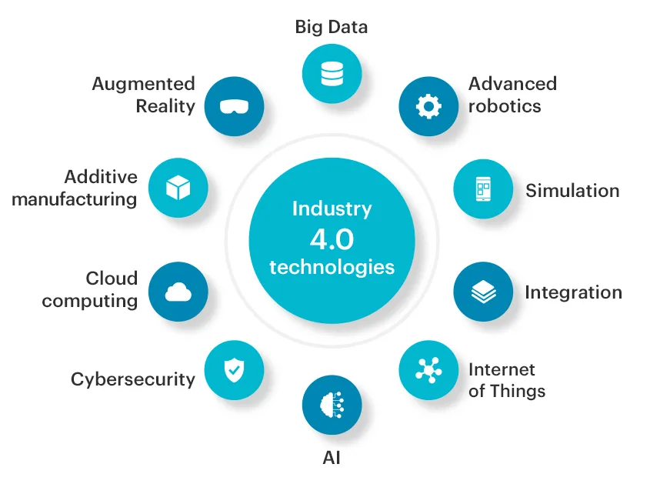
Industry 4.0 Technologies

Slide 8
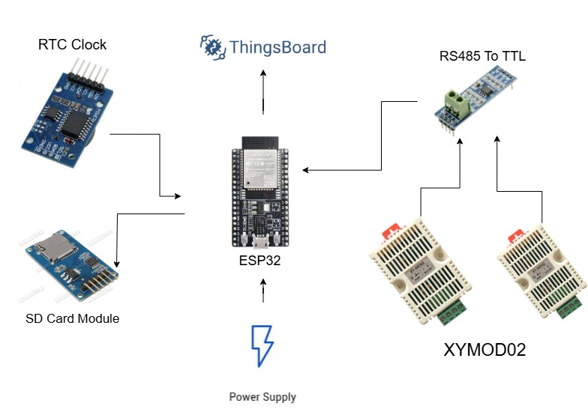
Block Diagram of Proposed Methodology

Slide 9
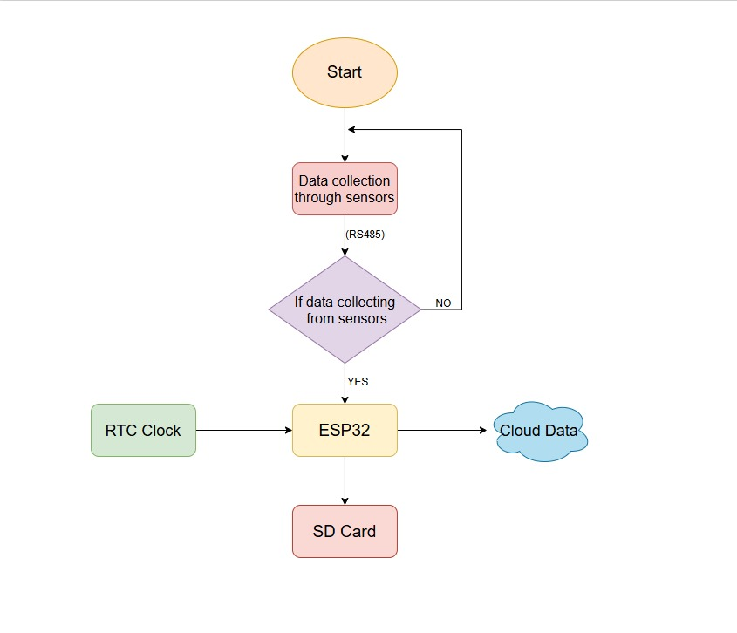
Flow Chart

Slide 10
Selection of Components
ESP-32 Microcontroller
RS485 Module
Real Time Clock (DS3231)
SD Card Module with SD Card
Industrial Sensors
IP65 Casing

Slide 11
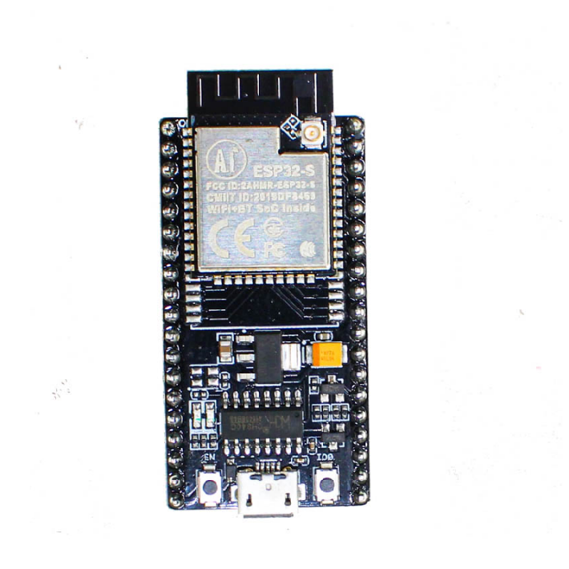
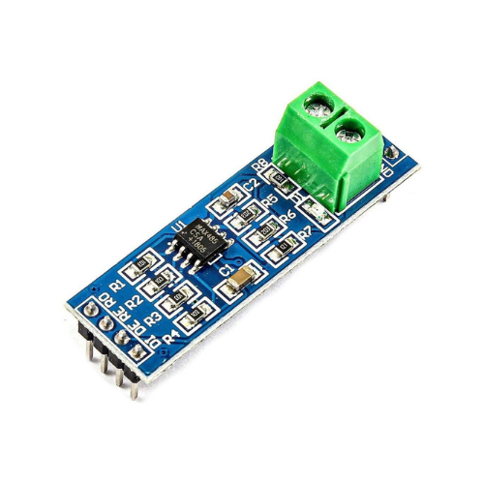
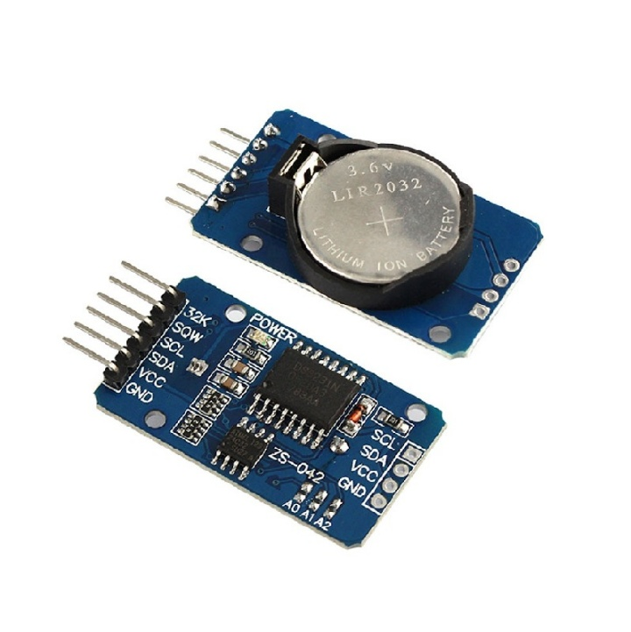
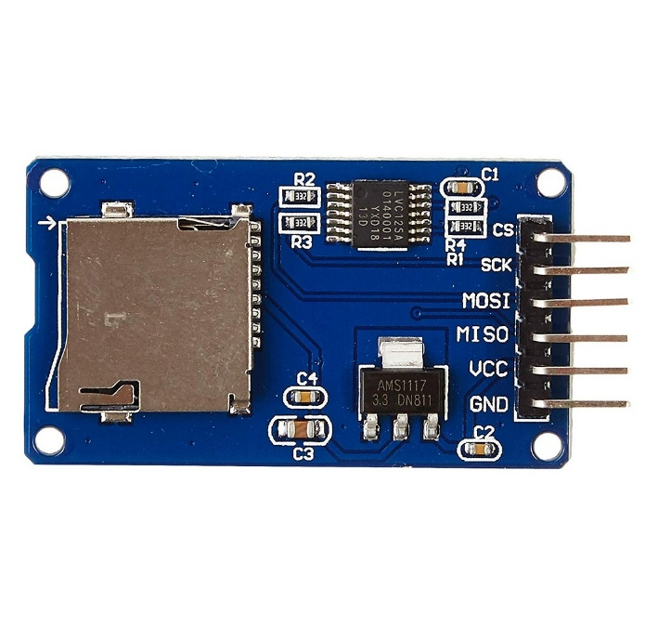
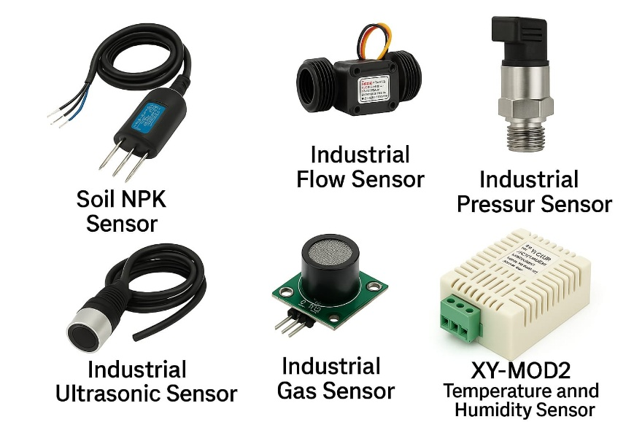
Hardware Components Used
RS485
RTC(DS3231)
Micro SD module
ESP32
Different Industrial Sensors

Slide 12
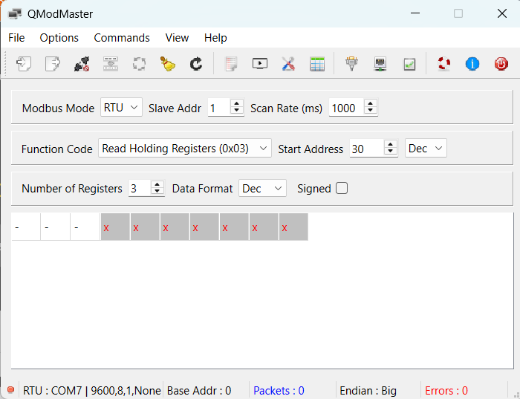


Software Tools used
Arduino IDE
KiCad
QModMaster

Slide 13
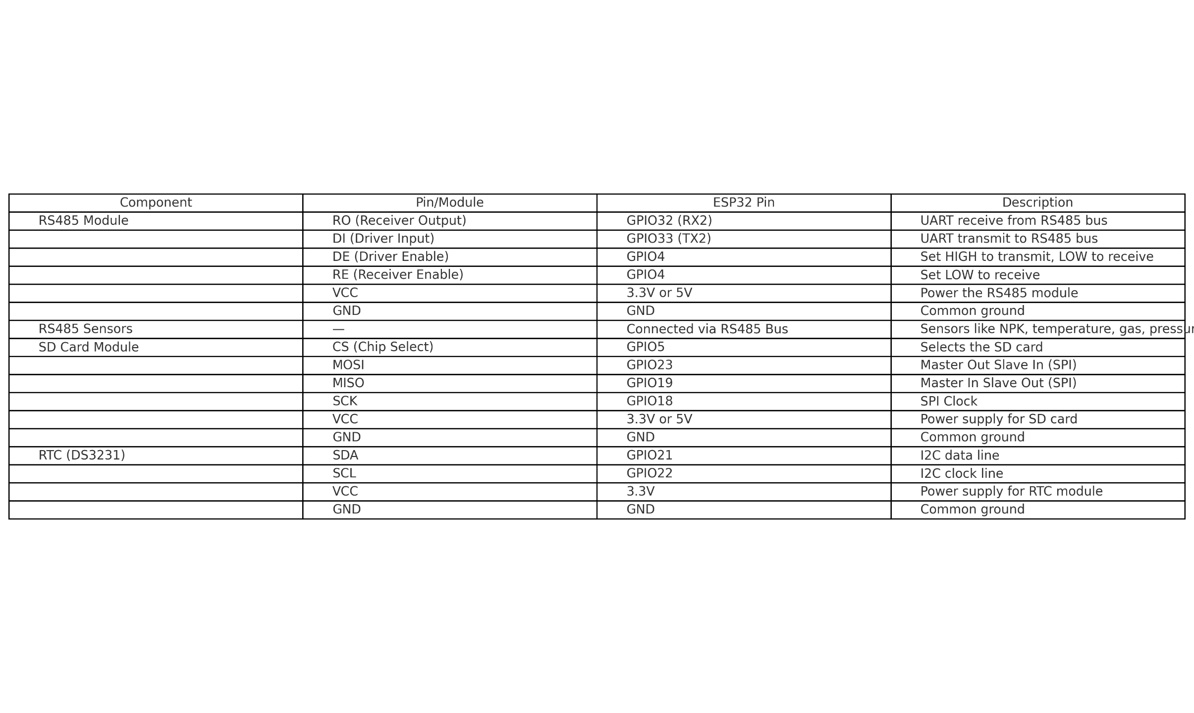
Connections & Configuration

Slide 14
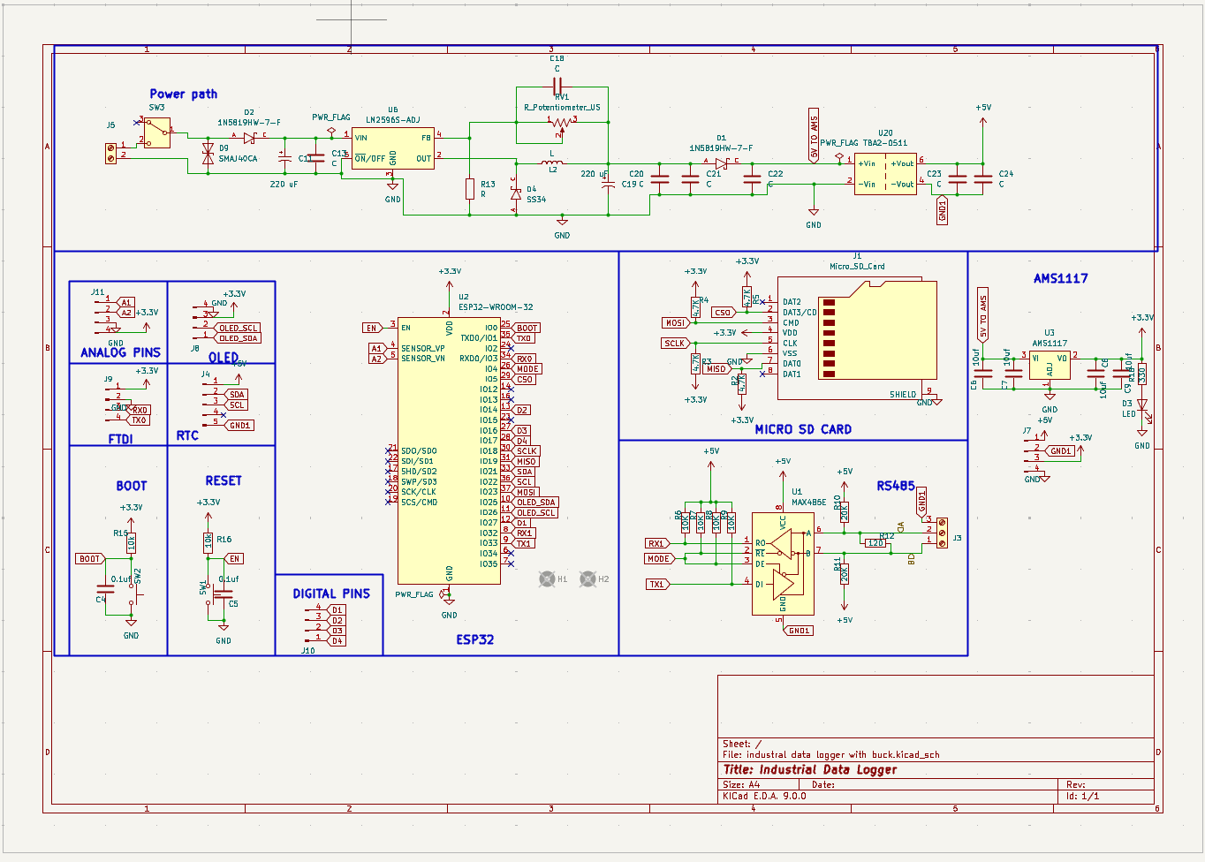
Schematic Diagram

Slide 15
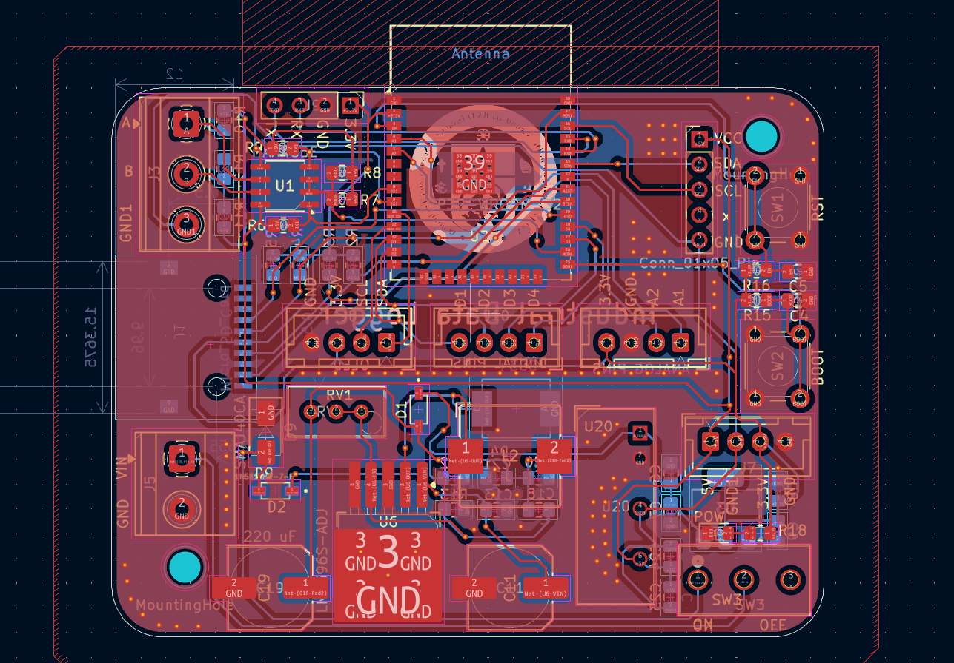
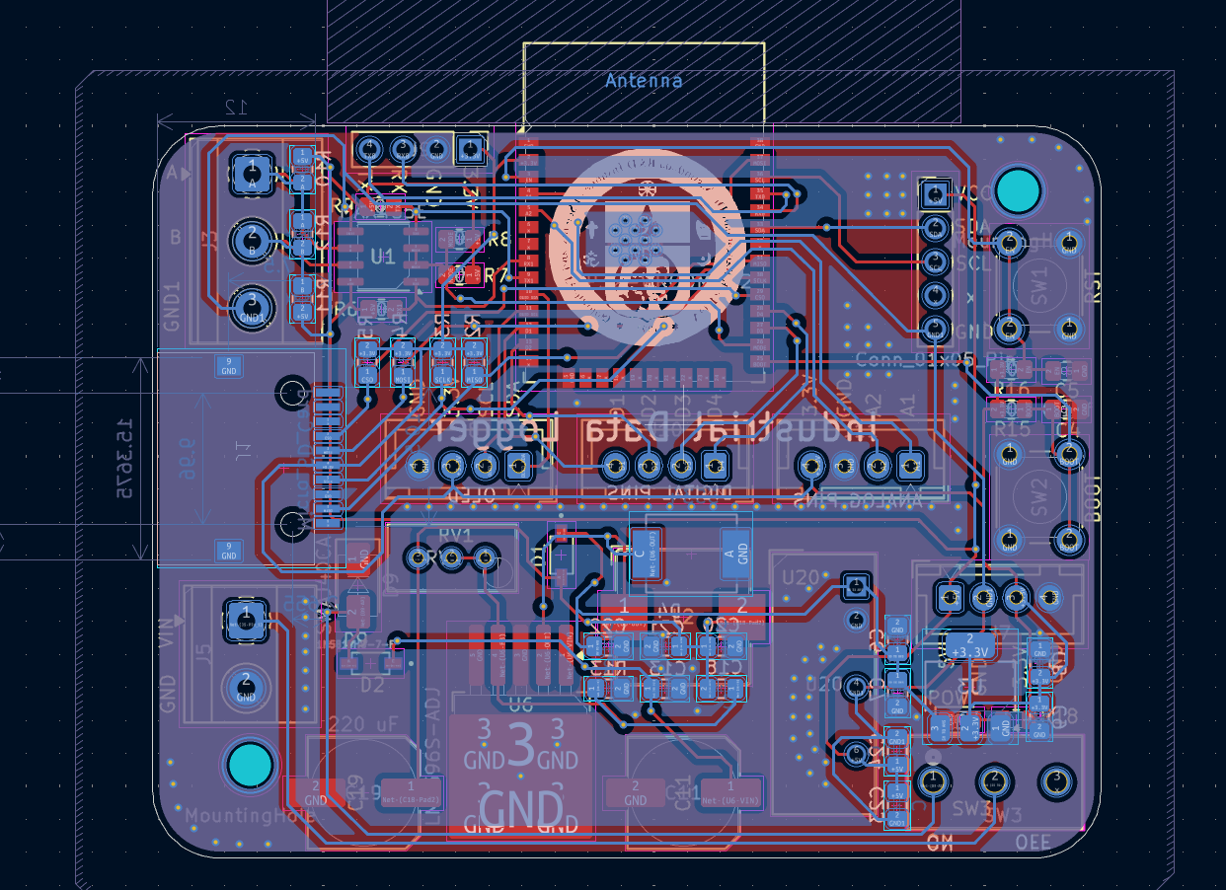
PCB Design
PCB Gerber Front View
PCB Gerber Rear View

Slide 16
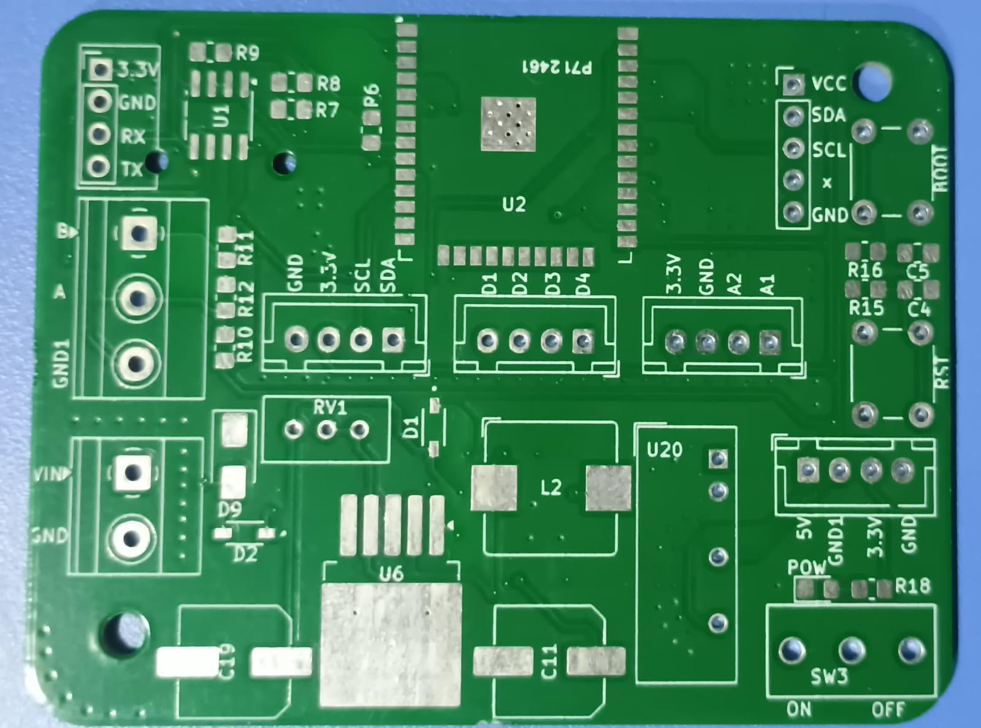
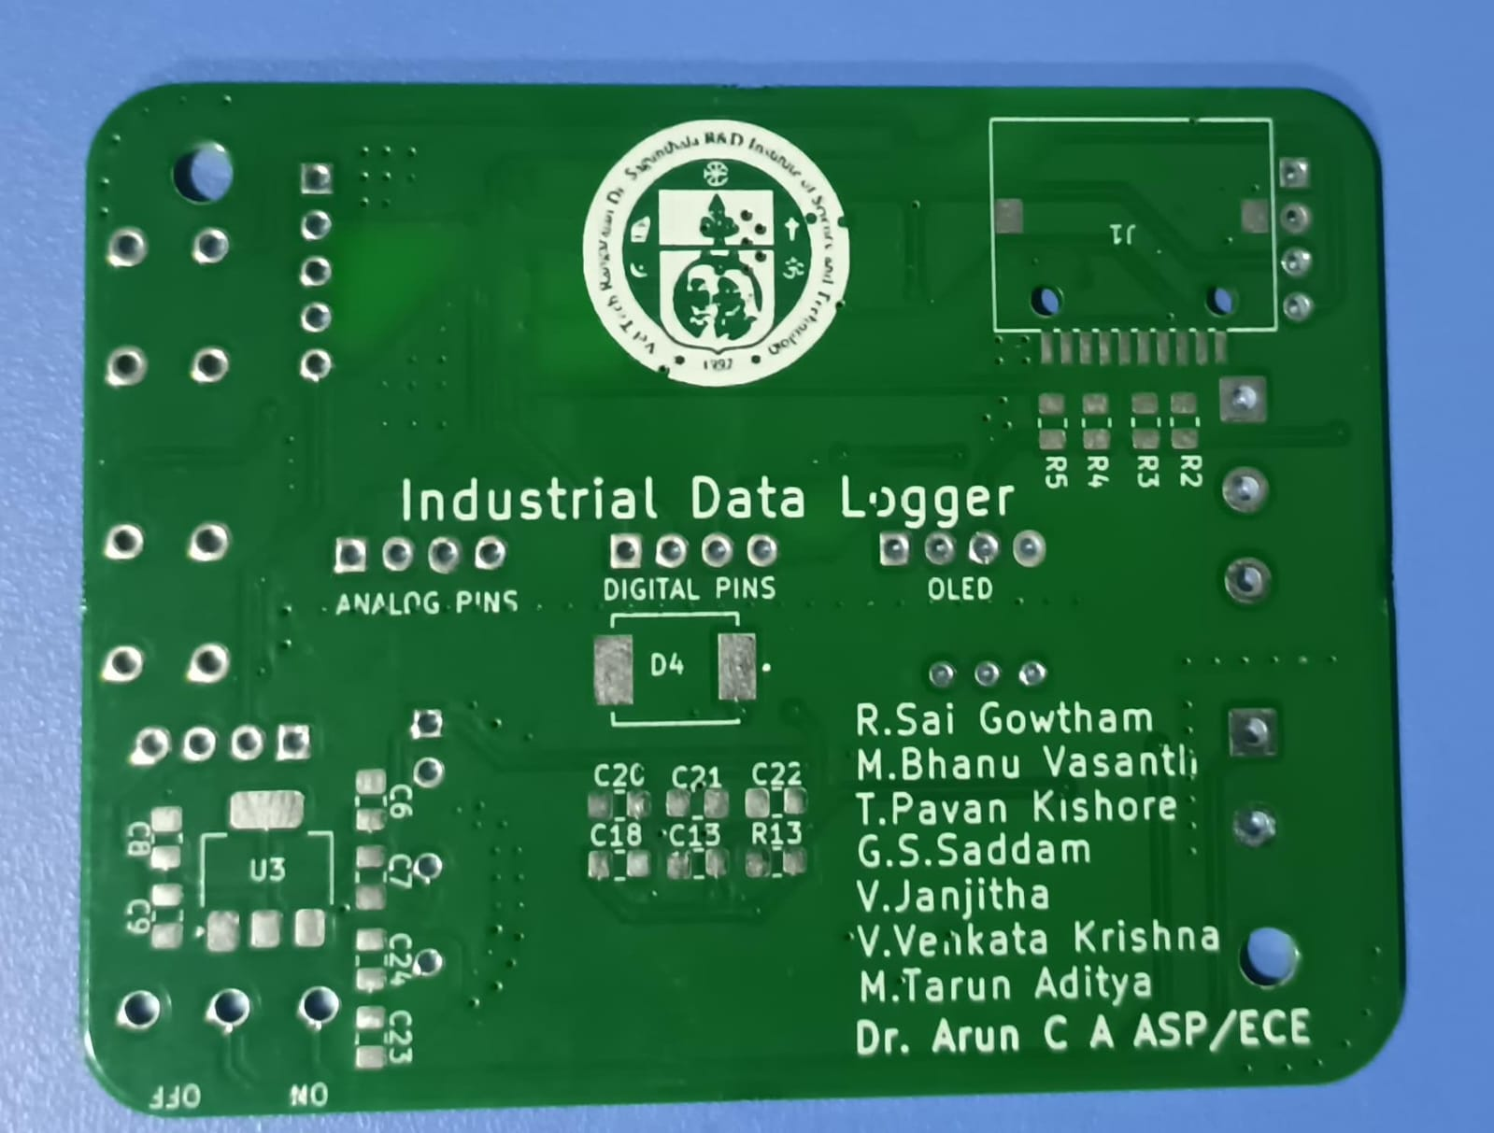
PCB Front View
PCB 3D Rear View

Slide 17
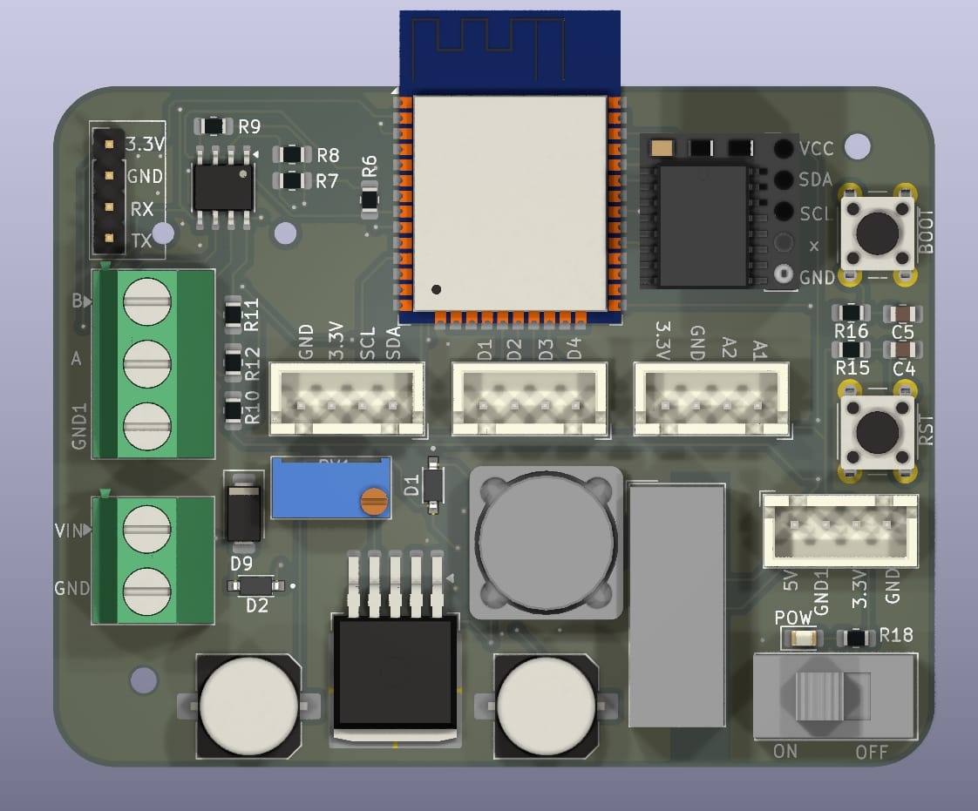
ESP32 WRoom chip
Programming pins
RTC
RS485
Power supply through PLC (upto27v)
On/Off Button
3D View of PCB
DC-DC Buck Converter

Slide 18
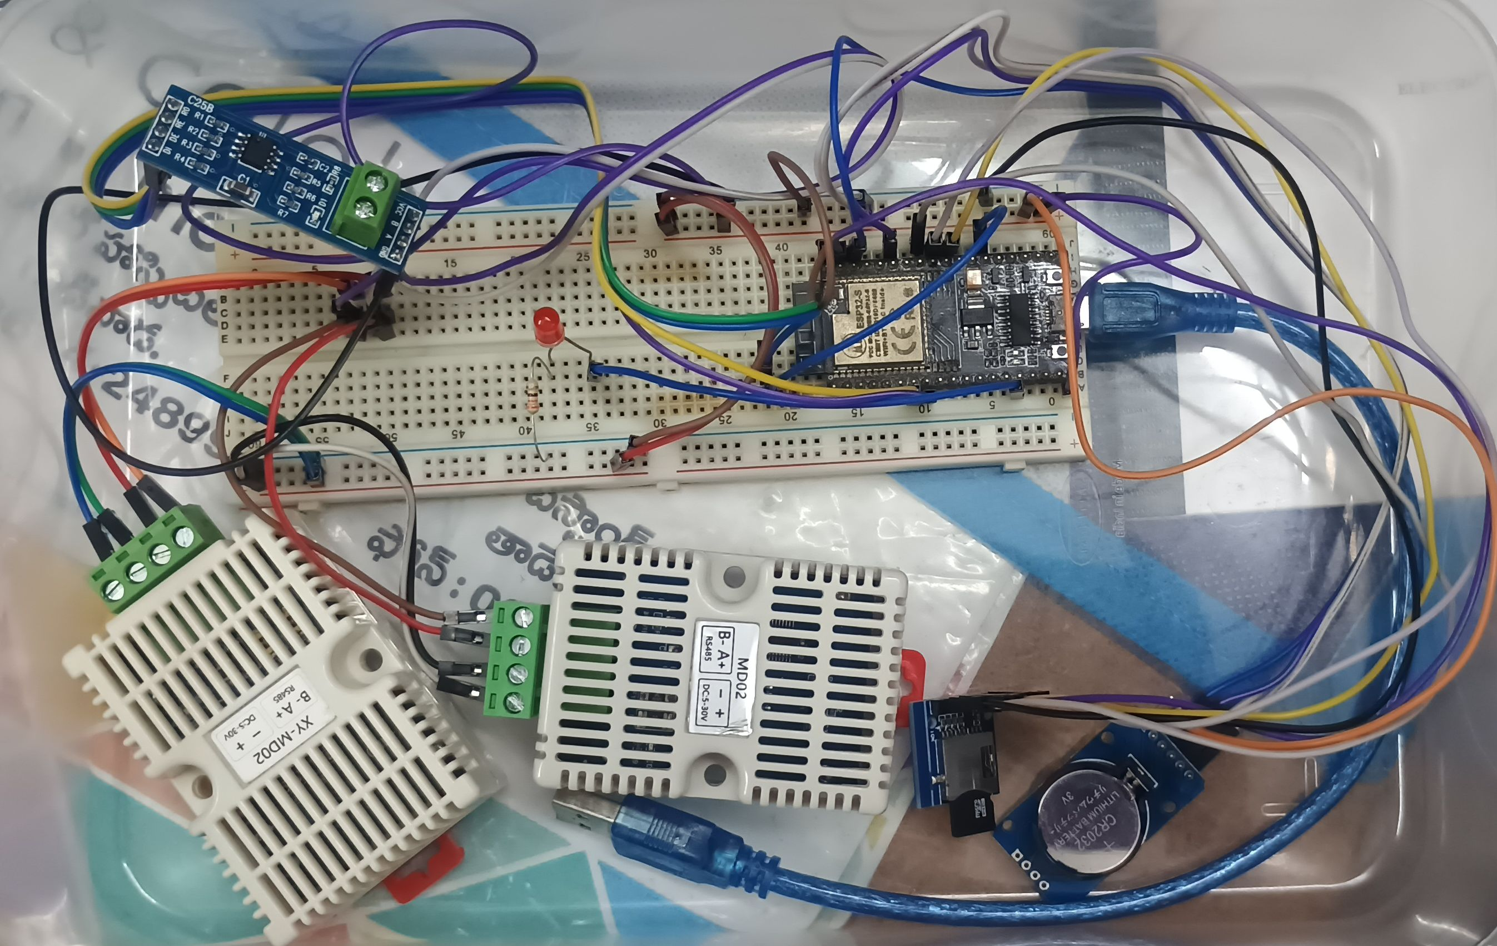
Design and Development
RS485
ESP32
RTC Clock
XYMOD02
XYMOD02
Micro SD card Module

Slide 19
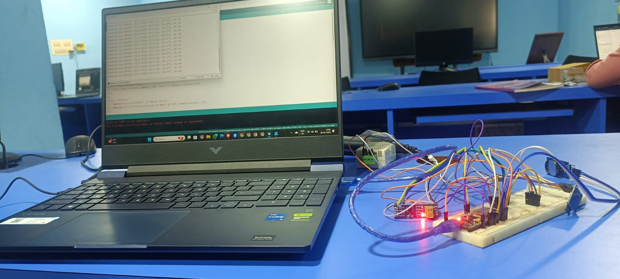
Results and Discussion

Slide 20
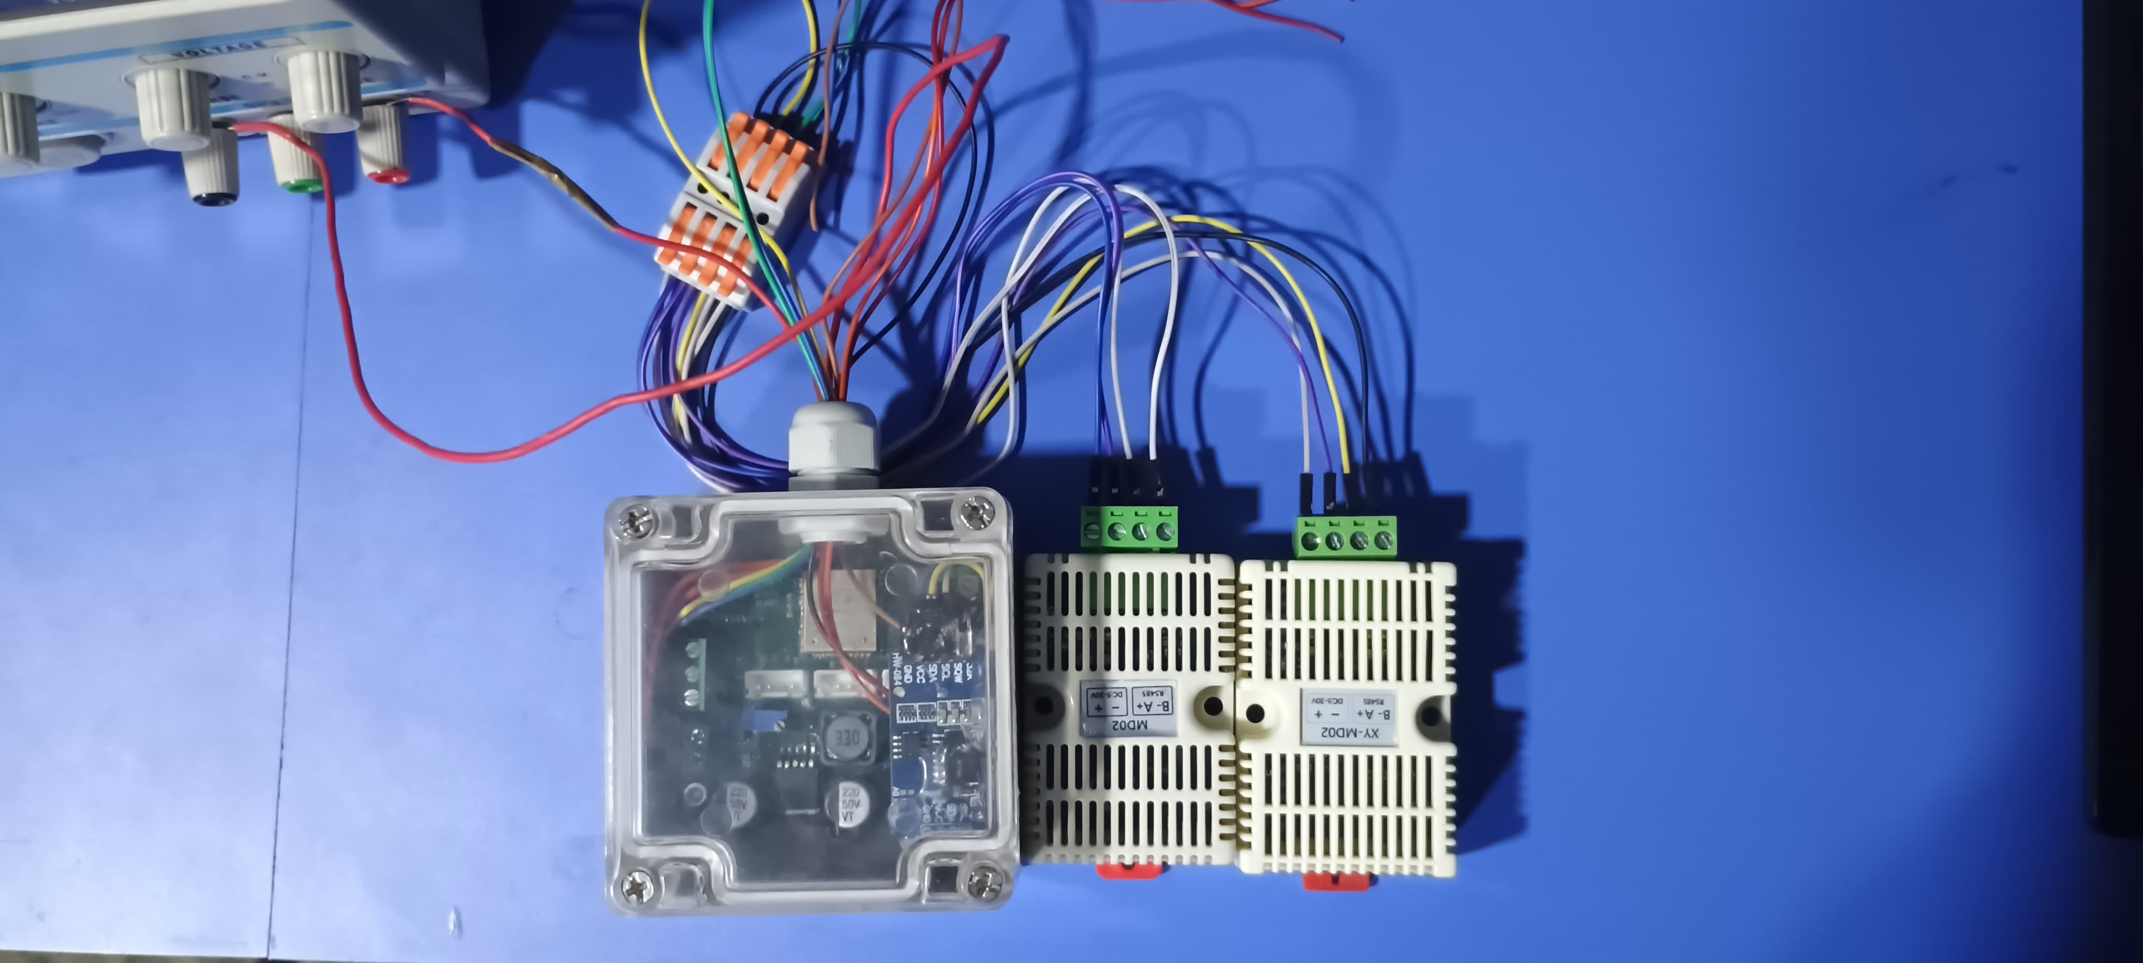
Developed Proposed System with IP65 Casing integrated with Industrial sensors

Slide 21
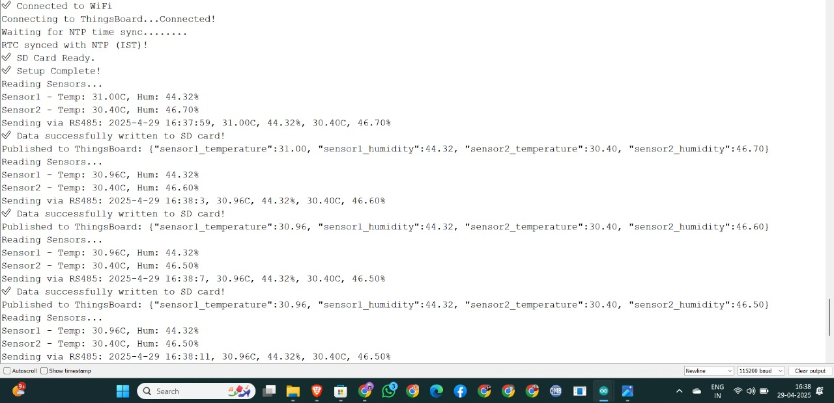
Results and Discussion
Serial Monitor
Accurate Time & date stamping

Slide 22
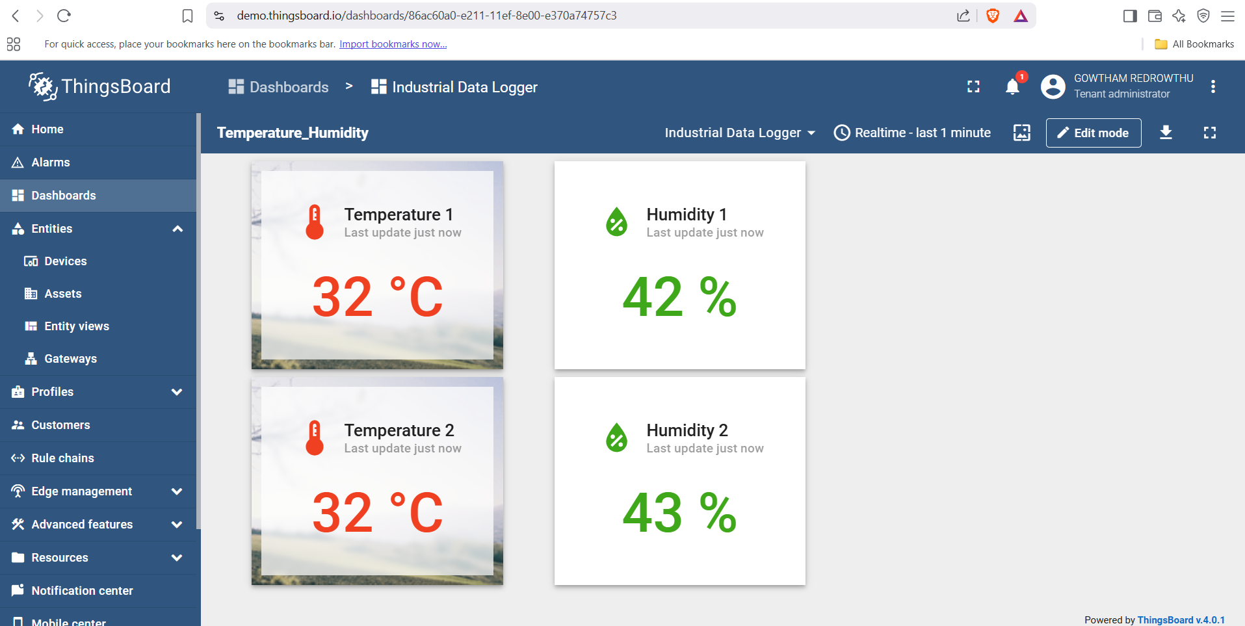
Data Pushed Into IoT Cloud
Data from Sensor 1
Data from Sensor 2
Data in Things Board Dashboard

Slide 23
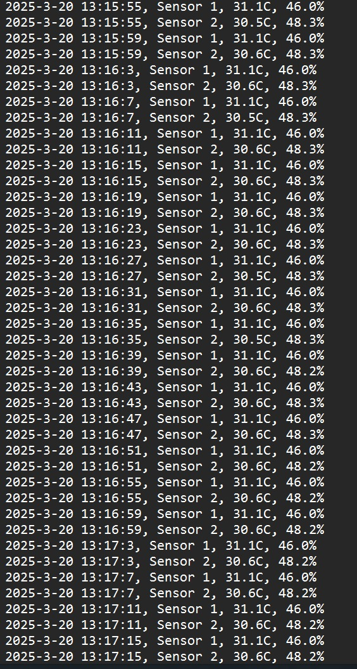
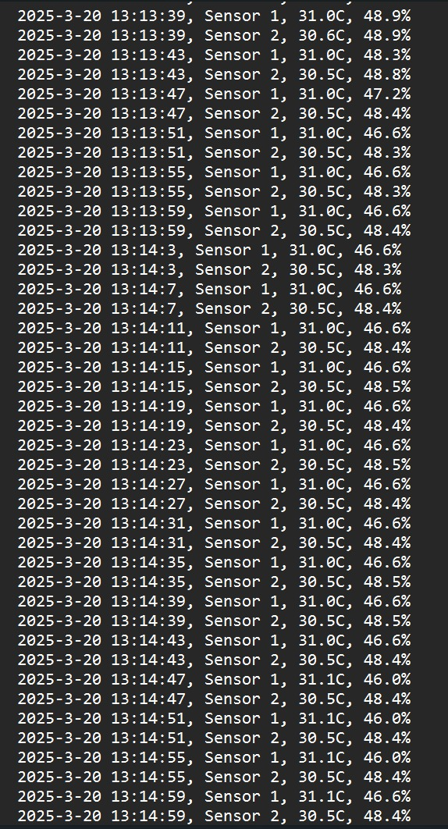
Data From SD Card
Date Time Sensors Temp Humd
Date Time Sensors Temp Humd
Data from Sensor2

Slide 24
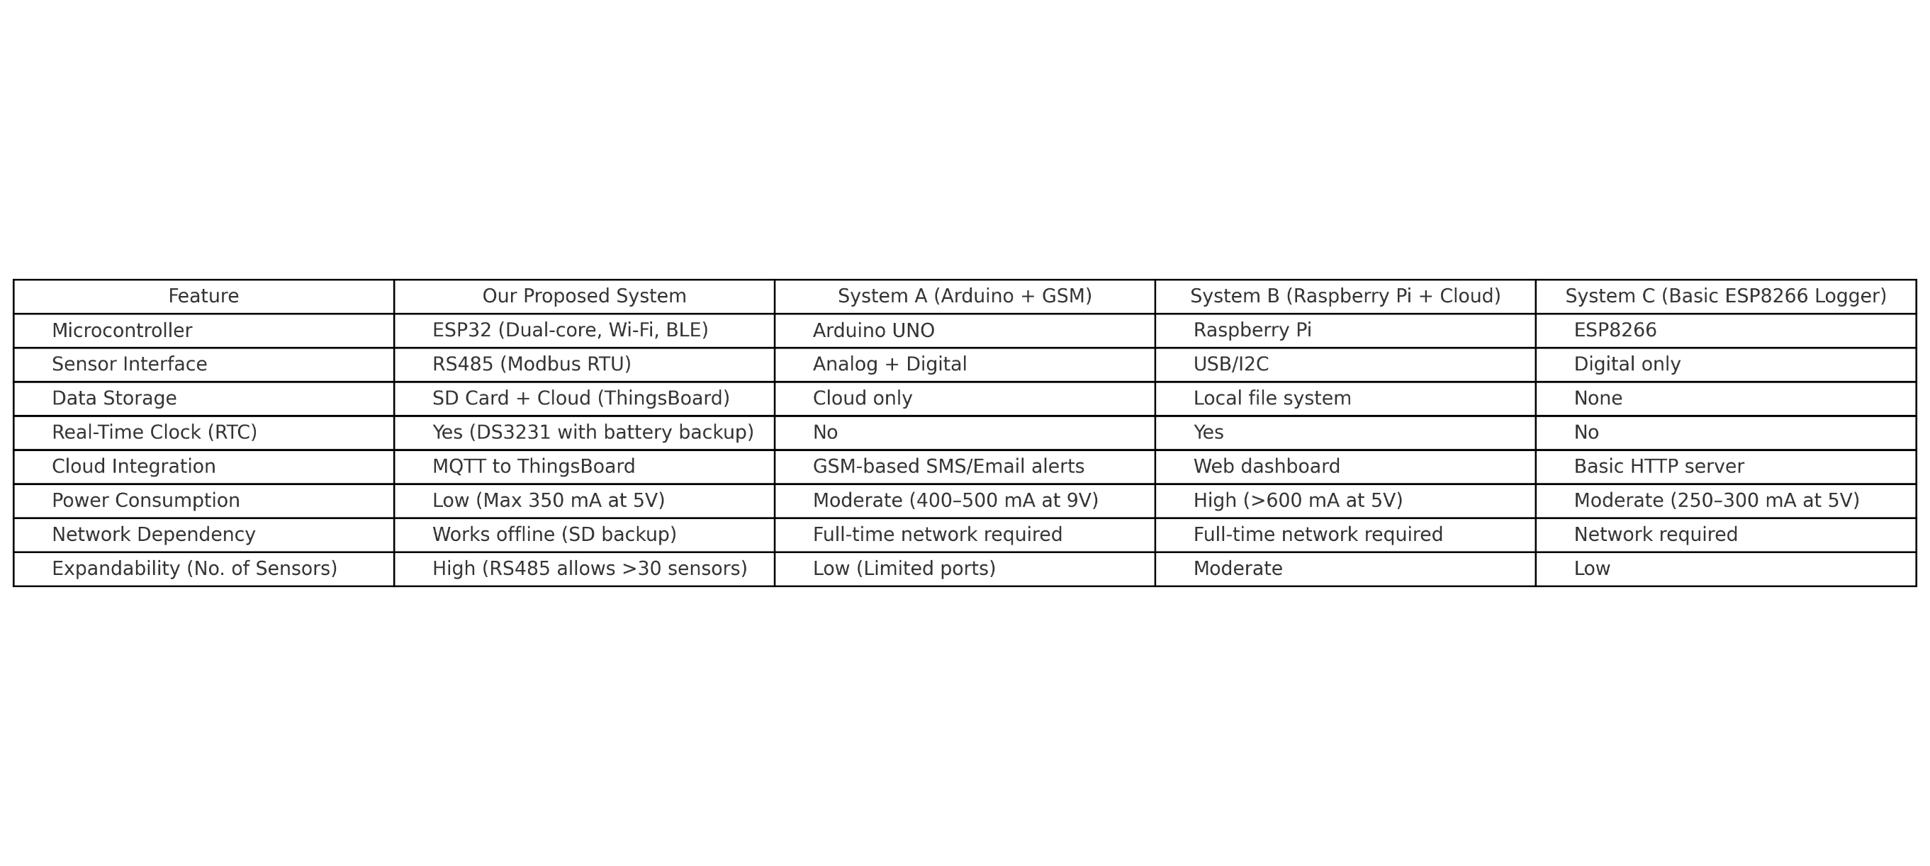
Comparison With Existing Systems

Slide 25
Conclusion
In conclusion, the data logger designed for Industry 4.0 effectively enables real-time monitoring and analysis of industrial parameters. It ensures accurate data acquisition from multiple sensors and devices across smart factories. By integrating with cloud platforms, it supports remote access and predictive maintenance.

Slide 26
Future Enhancements
Relay based Control System
Battery backup and Solar power
Mobile App Interface
Integration with AI/ML algorithms
Predictive Analytics .
Edge AI Capabilities

Slide 27
References
Kusuma, R. A., Karyadi, J. N. W., & Rahayoe, S. (2024). Design of a Low-Cost IoT-Based Data Logger for Monitoring the Palm Sugar Drying System Using ESP32 and Modbus/MQTT Conversion. 5th International Conference on Agricultural Engineering for Sustainable Agriculture Production (AESAP 2023), IOP Conf. Series: Earth and Environmental Science, Vol. 1386.
Anonymous. (2024). Cost-Effective IIoT Gateway Development Using ESP32 for Industrial Applications. Engineering Journal, Vol. 28, Issue 1.
O. Peter, A. Pradhan, and C. Mboh wa ., “Industrial internet of things (IIoT): opportunities, challenges, and requirements in manufacturing businesses in emerging economies,” Procedia Computer Science, vol. 217, pp. 856-865, 2023
M. M. Aljar rah , F. H. Zawai deh , M. Maga bleh, H. Al Wah shat , R. R. Mohamed and A. K. V, "Internet of Thing (IoT) and Data Analytics with Challenges and Future Applications," in 2023
M. D. Mudaliar and N. Sivakumar, “IoT based real time energy monitoring system using Raspberry Pi, Internet of Things, vol. 12, no. 100292, 2020.

Slide 28
References
Shaik, H., & Sree, L. (2020). IoT Based Smart Monitoring System Using ESP32 with Blynk Application. IJERT, Vol. 9 Issue 06.
W. Chen, “Intelligent manufacturing production line data monitoring system for industrial internet of things”, Computer Communications, vol. 151, pp. 31-41, 2020.
A. Zanella, N. Bui, A. Castellani, L. Vangelista and M. Zorzi, "Internet of Things for Smart Cities," in IEEE Internet of Things Journal, 2014.
Gubbi, J., Buyya, R., Marusic, S., & Palaniswami, M. (2013). Internet of Things (IoT): A vision, architectural elements, and future directions. Future Generation Computer Systems, Elsevier.

Slide 29


Slide 30


